Slide 1


Applied Virtual Networks
COMP 4912
Instructor: Dawood Sajjadi
PhD, SMIEEE, CISSP
ssajjaditorshizi@bcit.ca
Winter-Spring 2025
Week #2

Slide 2

Cloud Computing (Cloud Technology)
RECAP
What is Cloud Technology?
Cloud Technology enables access to computing resources like storage, databases, servers, and software over the internet.
Types of Cloud Models
Public Cloud: Shared resources provided by third-party vendors.
Private Cloud: Dedicated resources for one organization.
Hybrid Cloud: Combination of public and private clouds.
Multi-Cloud: Use of multiple cloud services from different providers.
Benefits
Scalability: Adjust resources based on demand.
Cost Efficiency: Pay-as-you-go pricing models.
Flexibility: Access from anywhere with internet.
Collaboration: Shared environments for teams and organizations.

Slide 3


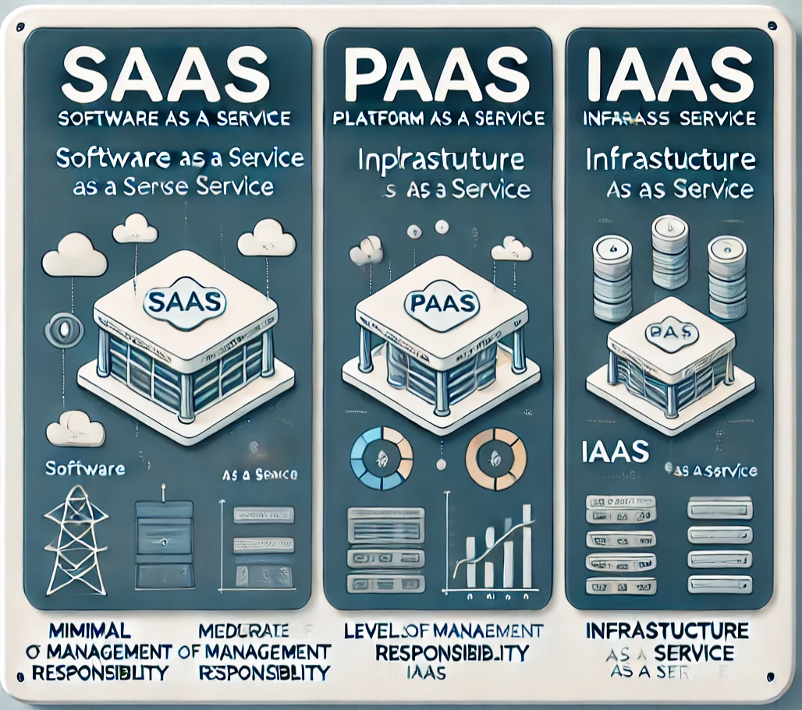




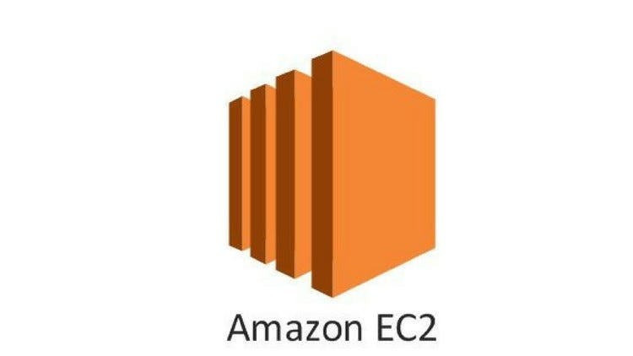

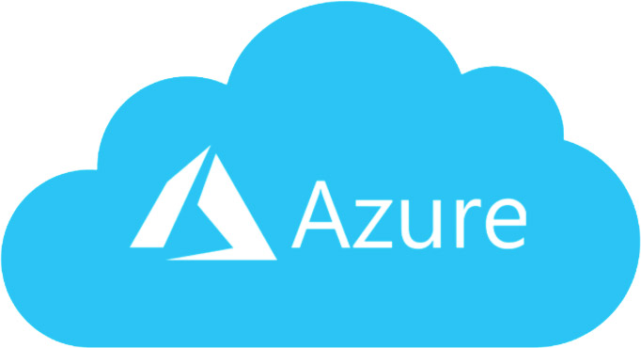
Cloud Computing (Cloud Technology)
RECAP
Cloud service models provide different levels of management, from full applications to bare infrastructure
SaaS (Software-as-a-Service):
Minimal user management (just access and settings).
PaaS (Platform-as-a-Service):
User manages applications and data, but not infrastructure.
IaaS (Infrastructure-as-a-Service):
User manages applications, data, and operating systems, but the provider manages hardware.

Slide 4
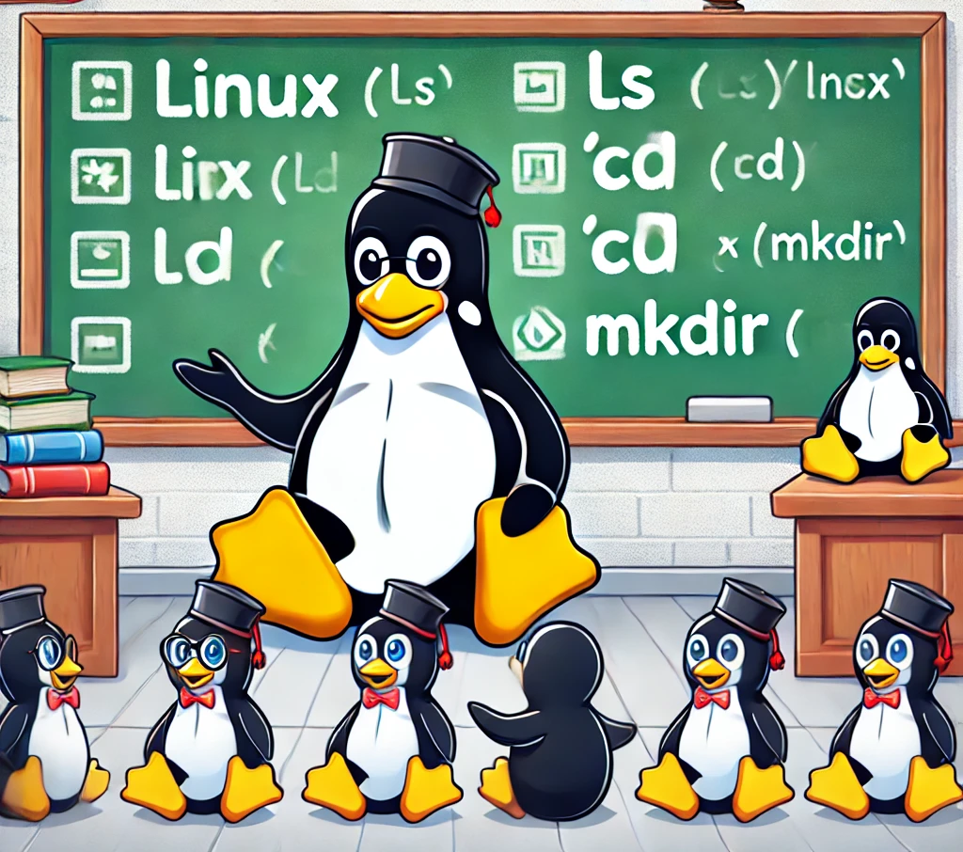
A Brief Intro to Linux
RECAP
Master the Basics/Concepts
Learn by Building Small Projects
Embrace Curiosity
Take Advantage of Online Materials
Join Linux Communities
cd, ls, pwd, hostname
cp, mv, rm, mkdir, rmdir, man
cat, vim, nano, touch, find, grep
uname, df, du, tar, fdisk, whoami
top, ps, kill, jobs, init, uptime, date
sudo, yum/apt, ssh, scp, history
curl, wget, ping, mtr, ip, ifconfig
netstat, iptables
Some basic commands
Some Nice References
https://linuxcommand.org/
https://linuxjourney.com/
https://linuxsurvival.com/

Slide 5
Learning Outcomes of Week #2
Explain the key applications of Virtualization technologies.
Name dominant Virtualization technologies.
Describe how can create and manage Virtual Machines (VMs).
Explain Container concept and its application.
Compare in details pros/cons of VMs and Containers.
Learn about Docker and basic commands to run/create a container.

Slide 6
Historical Overview
Multitenancy, containers and virtualization
(1960s-1970s) Time sharing and virtual memory;
(1970s) First hypervisor and VMs in IBM mainframes
(1980s-1990s) VMs on non-mainframe systems;
(2000 - 2005) FreeBSD Jails, Linux VServer, Virtuozzo/OpenVZ;
cgroups (~2006), LXC (2008), LXC-based Docker (2013), LXD (2014)

Slide 7
Virtualization
Operating Systems share HW resources between processes
Hypervisors share HW resources between Virtual Machines (VMs)
each VM has independent OS, utilities, libraries.
sharing HW across VMs improves utilization.
allows quick recovery of OS/Applications.
limits users’ access to specific roles (not root/admin).
allows to run applications regardless of underlying hardware or OS (more portability).
Virtualization does have performance impacts
Contention between VMs has nontrivial overheads
Un-tuned VMs may miss important memory features
Mismatched scheduling of VMs can slow multi-CPU runs
I/O virtualization is still costly

Slide 8
The Need for Virtualization and Containers
Sharing hardware via an operating system
Multi-tenant hosts:
Multiple users
Processes can be attributed to different users and groups
Processes share resources of an operating system (CPU, RAM, network devices, I/O devices, etc. via OS kernel)
IP address sharing via ports
Tenant separation:
Privileges are applied via an effective user and group and capabilities
File system permissions isolate access to regular files, directories, special files
Each process gets its own virtual memory
Context switches save/restore CPU state
Notes:
What is needed on the left
How it is done on the right

Slide 9
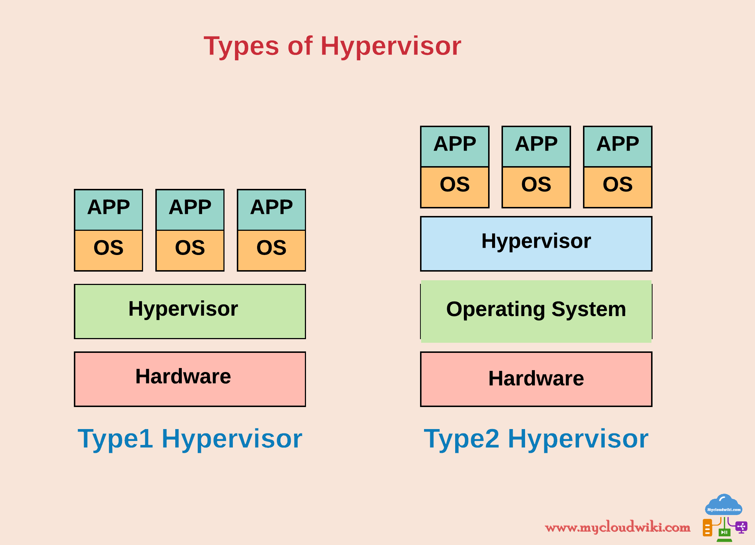

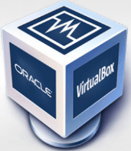
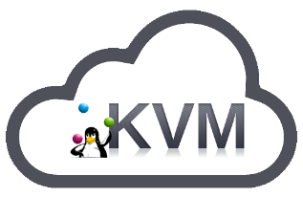
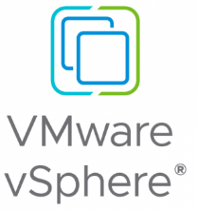
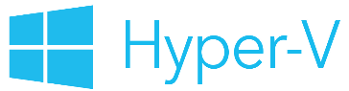

Virtual Machines
Types of Hypervisors
Type-1
Type-2
Bare-metal
Run guest-OS on top of host-OS

Slide 10
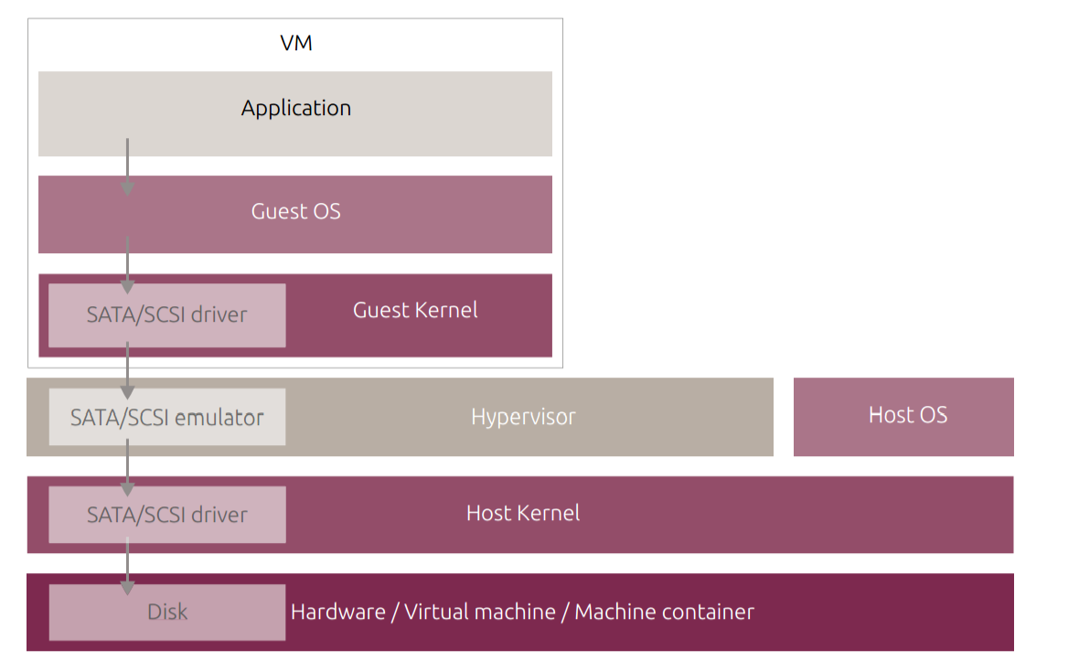
Virtual Machines

Slide 11
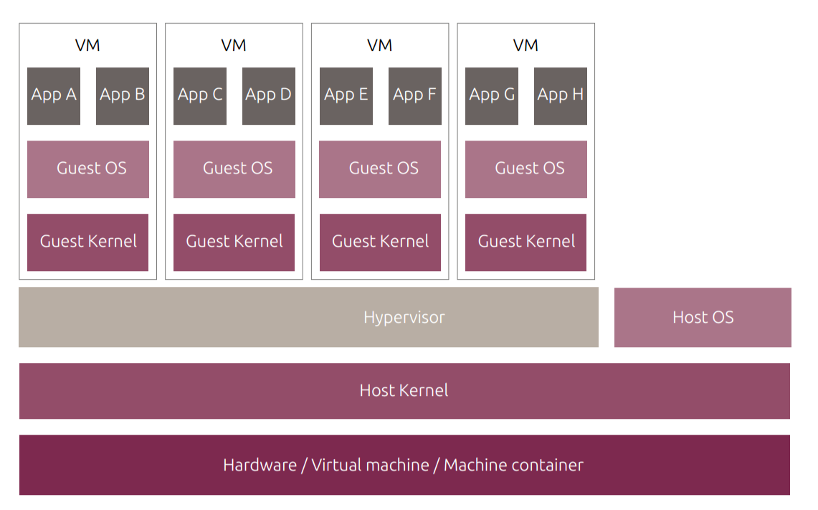
Virtual Machines

Slide 12
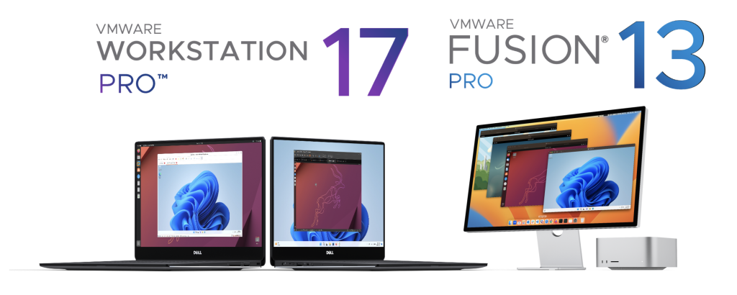
Virtual Machines (VMware)
VMware Workstation Professional
VMware Workstation Professional is a desktop virtualization software that allows you to run multiple operating systems (OS) on a single physical machine.
It creates a Virtual Environment where you can test, develop, and run different OSs without affecting your main system.
Supports popular operating systems like Windows, Linux, and macOS (via virtual machine emulation).

Slide 13
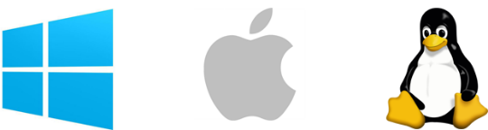

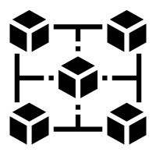
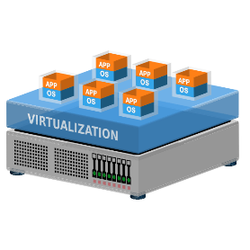

Virtual Machines (VMware)
Key Features (VMware Workstation Professional)
Multiple OS Support: Run multiple operating systems simultaneously (e.g., Windows, Linux)
Snapshots & Cloning: Create and restore snapshots of VMs, clone VMs to replicate environments.
Virtual Networking: Test networking configurations with virtual networks, including NAT/Bridged/Host-only modes.
Hardware Virtualization: Leverage advanced CPU and memory features for optimal performance.
3D Graphics Acceleration: Run graphic-intensive applications, including 3D software/games, inside VMs.

Slide 14
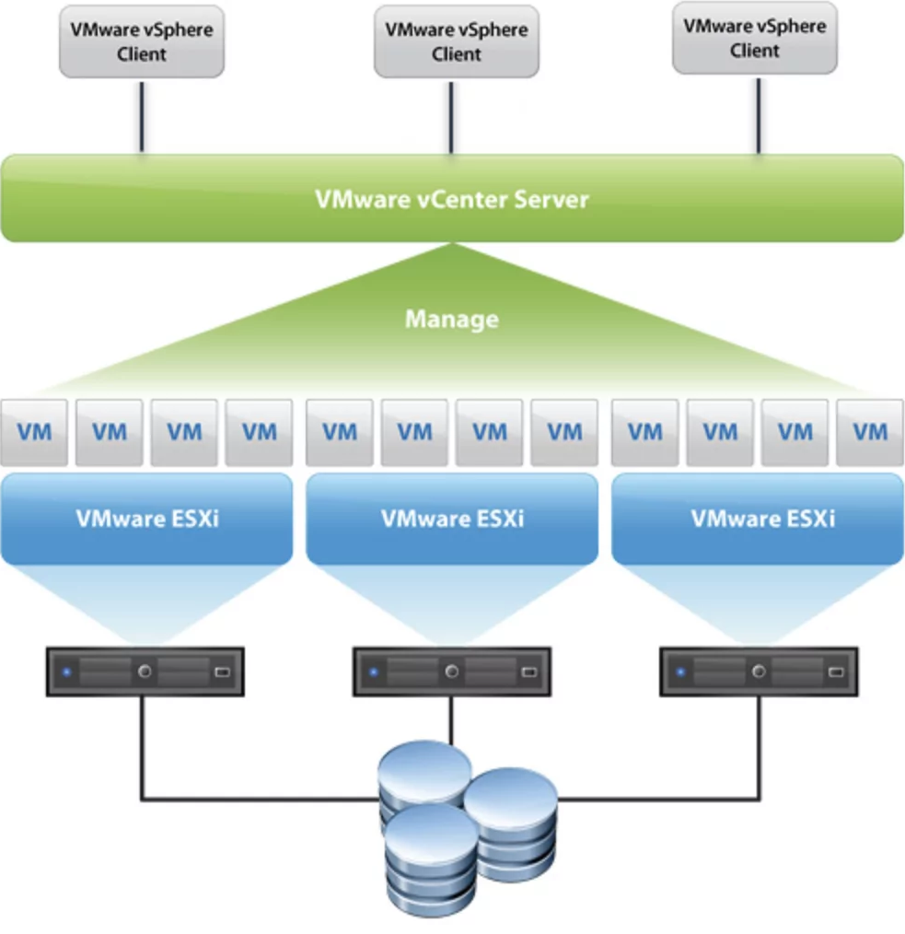
Virtual Machines (VMware)
Virtualization Capabilities in VMware Workstation
Isolated Testing Environments: Safe environments for testing software or operating systems without risk to your main OS.
Networking Simulation: Create complex networks with virtual routers, switches, and virtual machines.
Integration with VMware vSphere: Seamlessly move virtual machines between VMware Workstation and vSphere, enabling hybrid cloud environments.

Slide 15
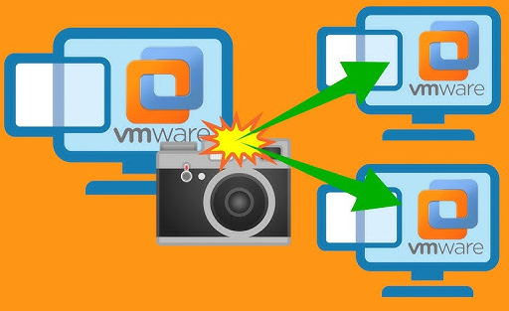
Virtual Machines (VMware)
Snapshots/Cloning
Snapshots: Take a snapshot of your VM at any time to save its state. Revert to it later if needed.
Cloning: Create an exact copy of a virtual machine for testing different configurations or versions of software.
Use Cases: Test software updates, security patches, or other changes without affecting your primary environment.

Slide 16
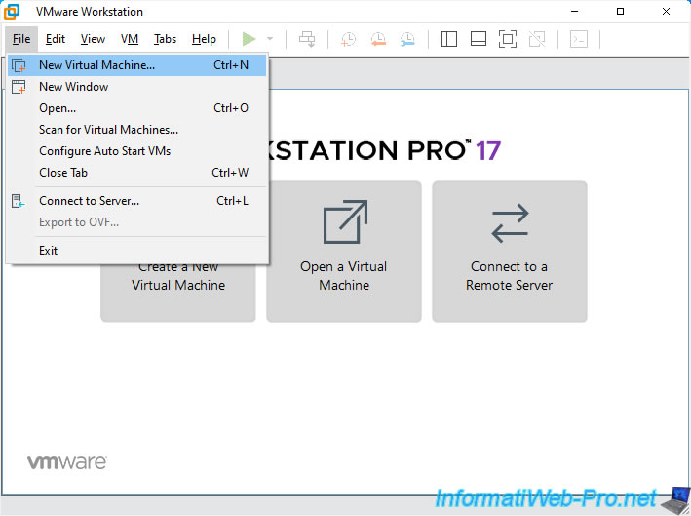
Virtual Machines (VMware)
Why use VMware Workstation Professional?
Safety: Test new software or configurations in a safe, isolated environment.
Cost-effective: No need for multiple physical machines. Save on hardware costs.
Flexibility: Easily switch between different OSes without rebooting.
Learning Tool: Perfect for students, developers, and IT professionals to learn and experiment with various operating systems and configurations.

Slide 17
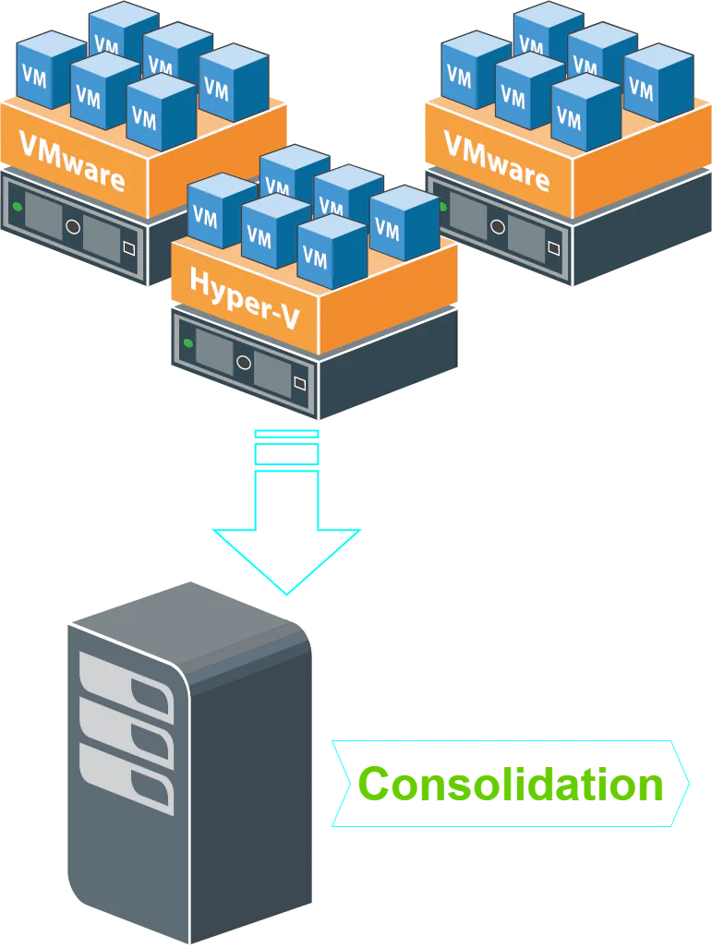
Virtual Machines (VMware)
System Requirements for VMware Workstation
A compatible 64-bit x86/AMD64 CPU launched in 2011 or later
1.3GHz or faster core speed
AMD CPU requires AMD-V. Intel CPU requires VT-x
2GB RAM minimum/ 4GB RAM or more recommended
VMware Workstation Pro and Player run on most 64-bit Windows or Linux host OS
VMware Workstation 17 supports hundreds of 32-bit and 64-bit guest OS. Here is a list of the most popular:
Windows
Ubuntu
RedHat
SUSE
Oracle Linux
Debian
Fedora
OpenSUSE
Mint
CentOS
Solaris, FreeBSD, and various other Linux Distros
Reference: https://docs.vmware.com/en/VMware-Workstation-Pro/17.5.2/rn/vmware-workstation-1752-pro-release-notes/index.html

Slide 18
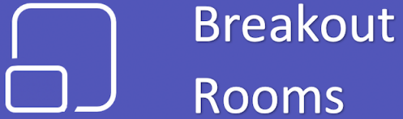
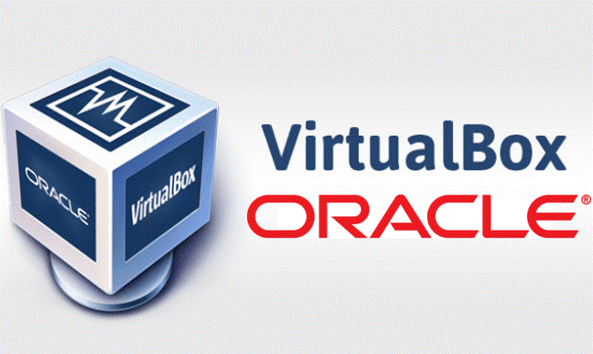
Virtual Machines (VMware)
Interactive Demo
&
1
Download CentOS 8 VMware Image:
https://www.linuxvmimages.com/images/centos-8/
In Windows, ensure 7z (https://7-zip.org/download.html) installed.

Slide 19
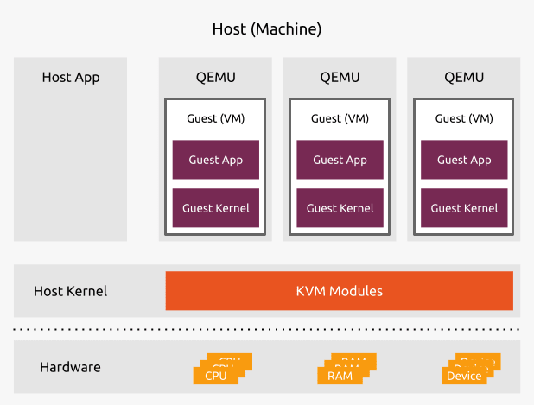
Virtual Machines (KVM)
KVM hypervisor enables full virtualization capabilities. It provides each VM with all typical services of the physical system, including virtual BIOS/Hardware, such as processor, memory, storage, and network cards. As a result, every VM completely simulates a physical machine.
KVM is available as a Linux Kernel module. It plugs directly into the kernel’s code and allows it to function as a Hypervisor. Every VM runs as a separate Linux process with dedicated virtual hardware. KVM can only be used on a CPU with extensions such as Intel-VT or AMD-V.
Will discuss it more in the next Lecture.
Notes:
Kernel-based Virtual Machine

Slide 20

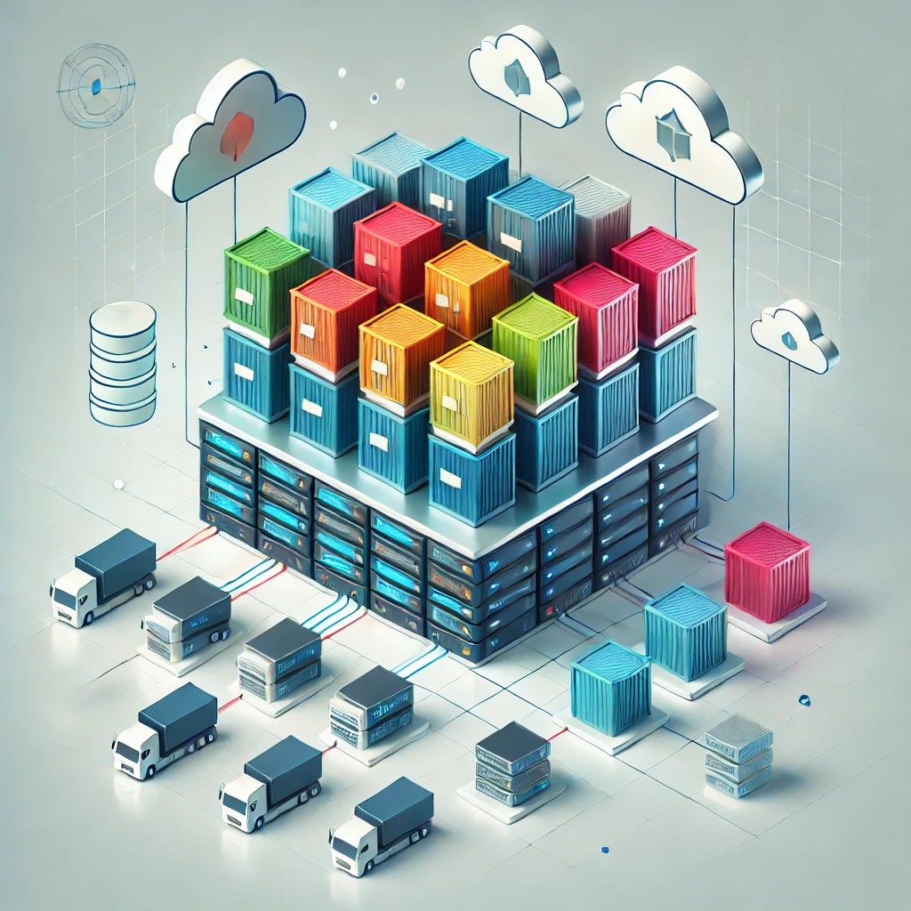
What is Container and Why use it?

Slide 21



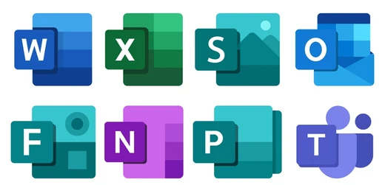




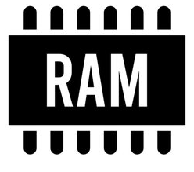
A Typical Coding Day
System Call
System Call
System Call
Build code (4x languages, many libraries)
Doesn’t work; install missing library
Requires different version of a dependency
Install new version, breaking different package
KERNEL
Notes:
System call: it is an interface between a program running in user space and the operating system (OS). Application programs use system calls to request services and functionalities from the OS's kernel.

Slide 22
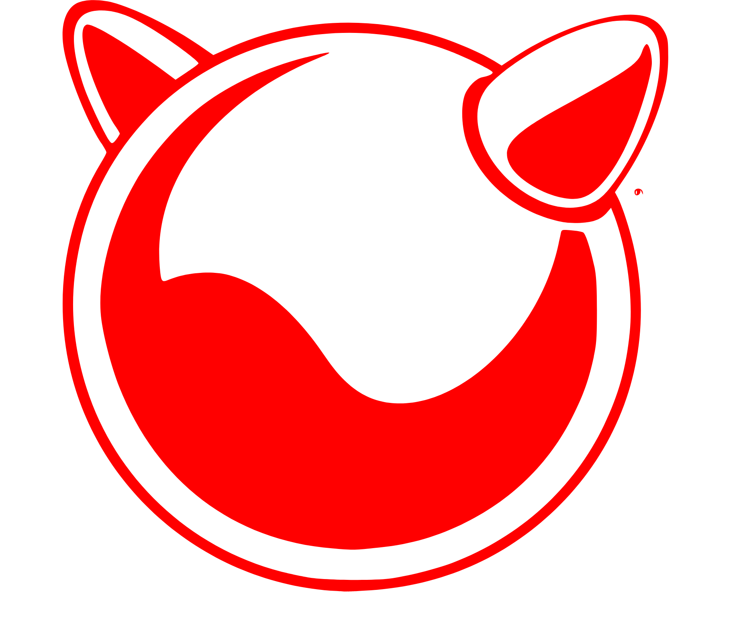

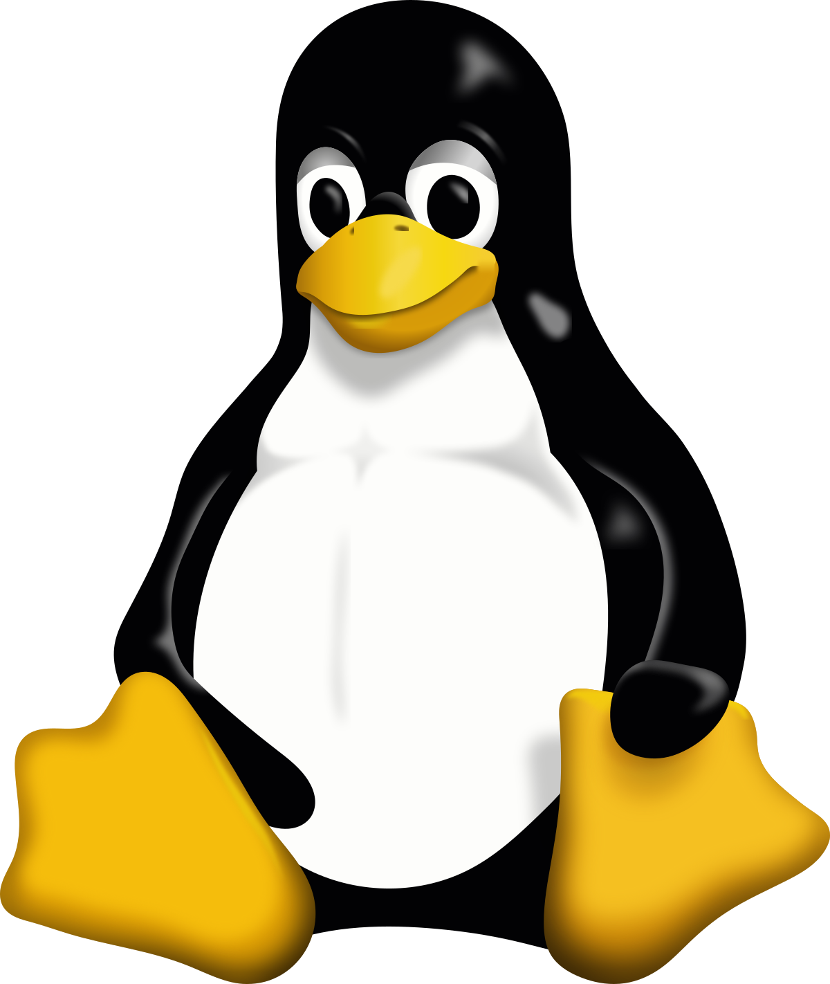
Definition of a Container
A Container is a process or a process tree isolated from other processes via Linux kernel mechanisms such as namespaces and constrained in resource usage via cgroups and filesystem-specific features.
Containerized Applications
App A
App B
App C
App D
App G
App I
App H
App J
App K
Kernel
Kernel
Kernel
App A
App B
App C
App D
App E
App F
VM-1
VM-2
VM-3
Container Runtime (Docker, containerd)
Guest OS
Guest OS
Guest OS
Kernel
Hypervisor (VMware, Hyper-V, KVM, Xen)
Host Operating System (Window/Linux)
Physical/Hardware Infrastructure (Server)
Physical/Hardware Infrastructure (Server)

Slide 23
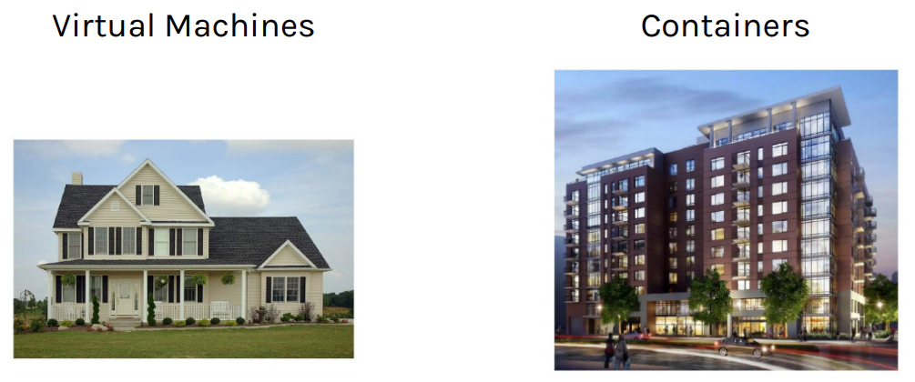
Containers vs Virtual Machines

Slide 24
Why use Containers?
Containers are best suited to deliver micro-services by providing portable, isolated virtual environments for applications to run without interference from other running applications. Each container has its own file-system, processes, no shared libs across containers
2. Containers run container images, it bundles the application along with its runtime and dependencies.
3. Containers are lightweight, you can have many containers running at once on your system.
4. Containers startup time is on the order of Seconds, but it is Minutes for the VMs (Faster boot-time and creation-time).
Containerized Applications
App G
App I
App H
App J
App K
App A
App B
App C
App D
App E
App F
Container Runtime (Docker, containerd)
Kernel
Host Operating System (Window/Linux)
Physical/Hardware Infrastructure (Server)
Containers are Application-centric methods to deliver high-performing, scalable app on any infrastructure of your choice. You can develop your code on your laptop and Run anywhere, without being worried for dependencies.
VMs provide strong isolation between processes sharing (better security) on the same Hardware/OS. Containers run on one Operating System, which has weaker isolation (less security), but lower overhead.

Slide 25
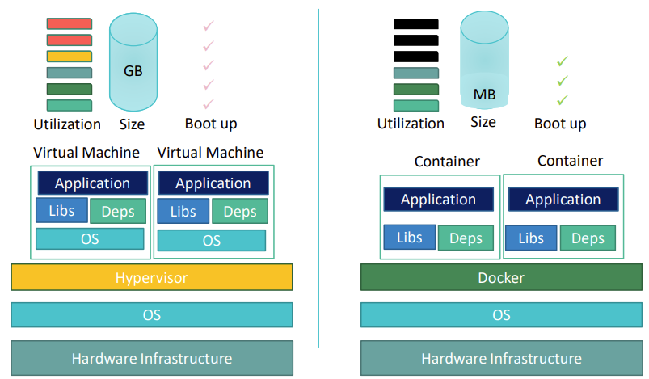
Containers vs Virtual Machines
Created from Container images
With the same container image, you can reproduce as many containers as you wish.
Think about the image as the recipe, and the container as the cake.
You can make as many cakes as you’d like with a given recipe.

Slide 26
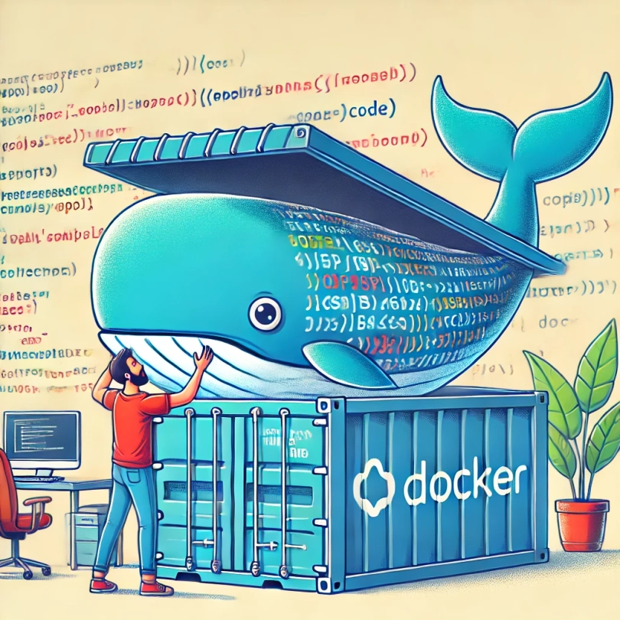
What is Docker?
Docker is an open-source platform that simplifies Application Development by creating lightweight, portable Containers that package code and its dependencies.
Indeed, Docker ensures consistency across different platform & environments, enabling quick and reliable testing, deployment, and scaling.

Slide 27
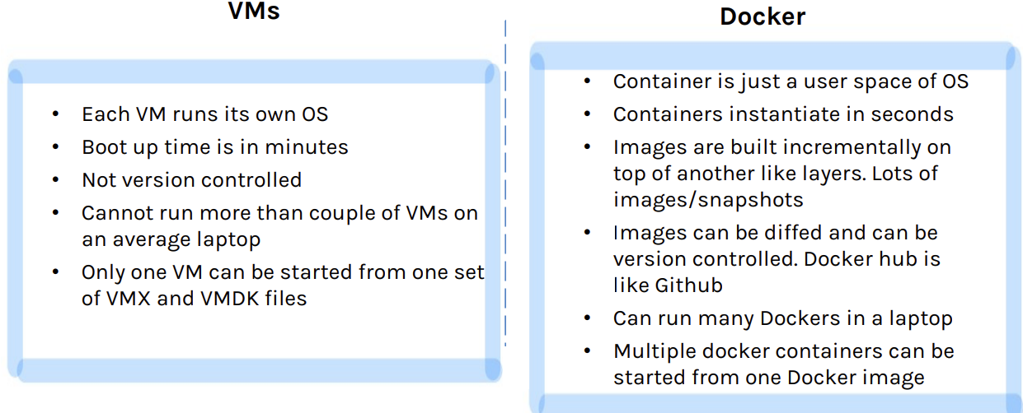
Containers vs Virtual Machines
Docker Containers
The advantage of using containers is that they only virtualize the operating system and do not require dedicated piece of hardware because they share the same kernel of the hosting system.
Containers give the impression of a separate OS, however, since they're sharing the kernel, they are much cheaper than a VM.

Slide 28
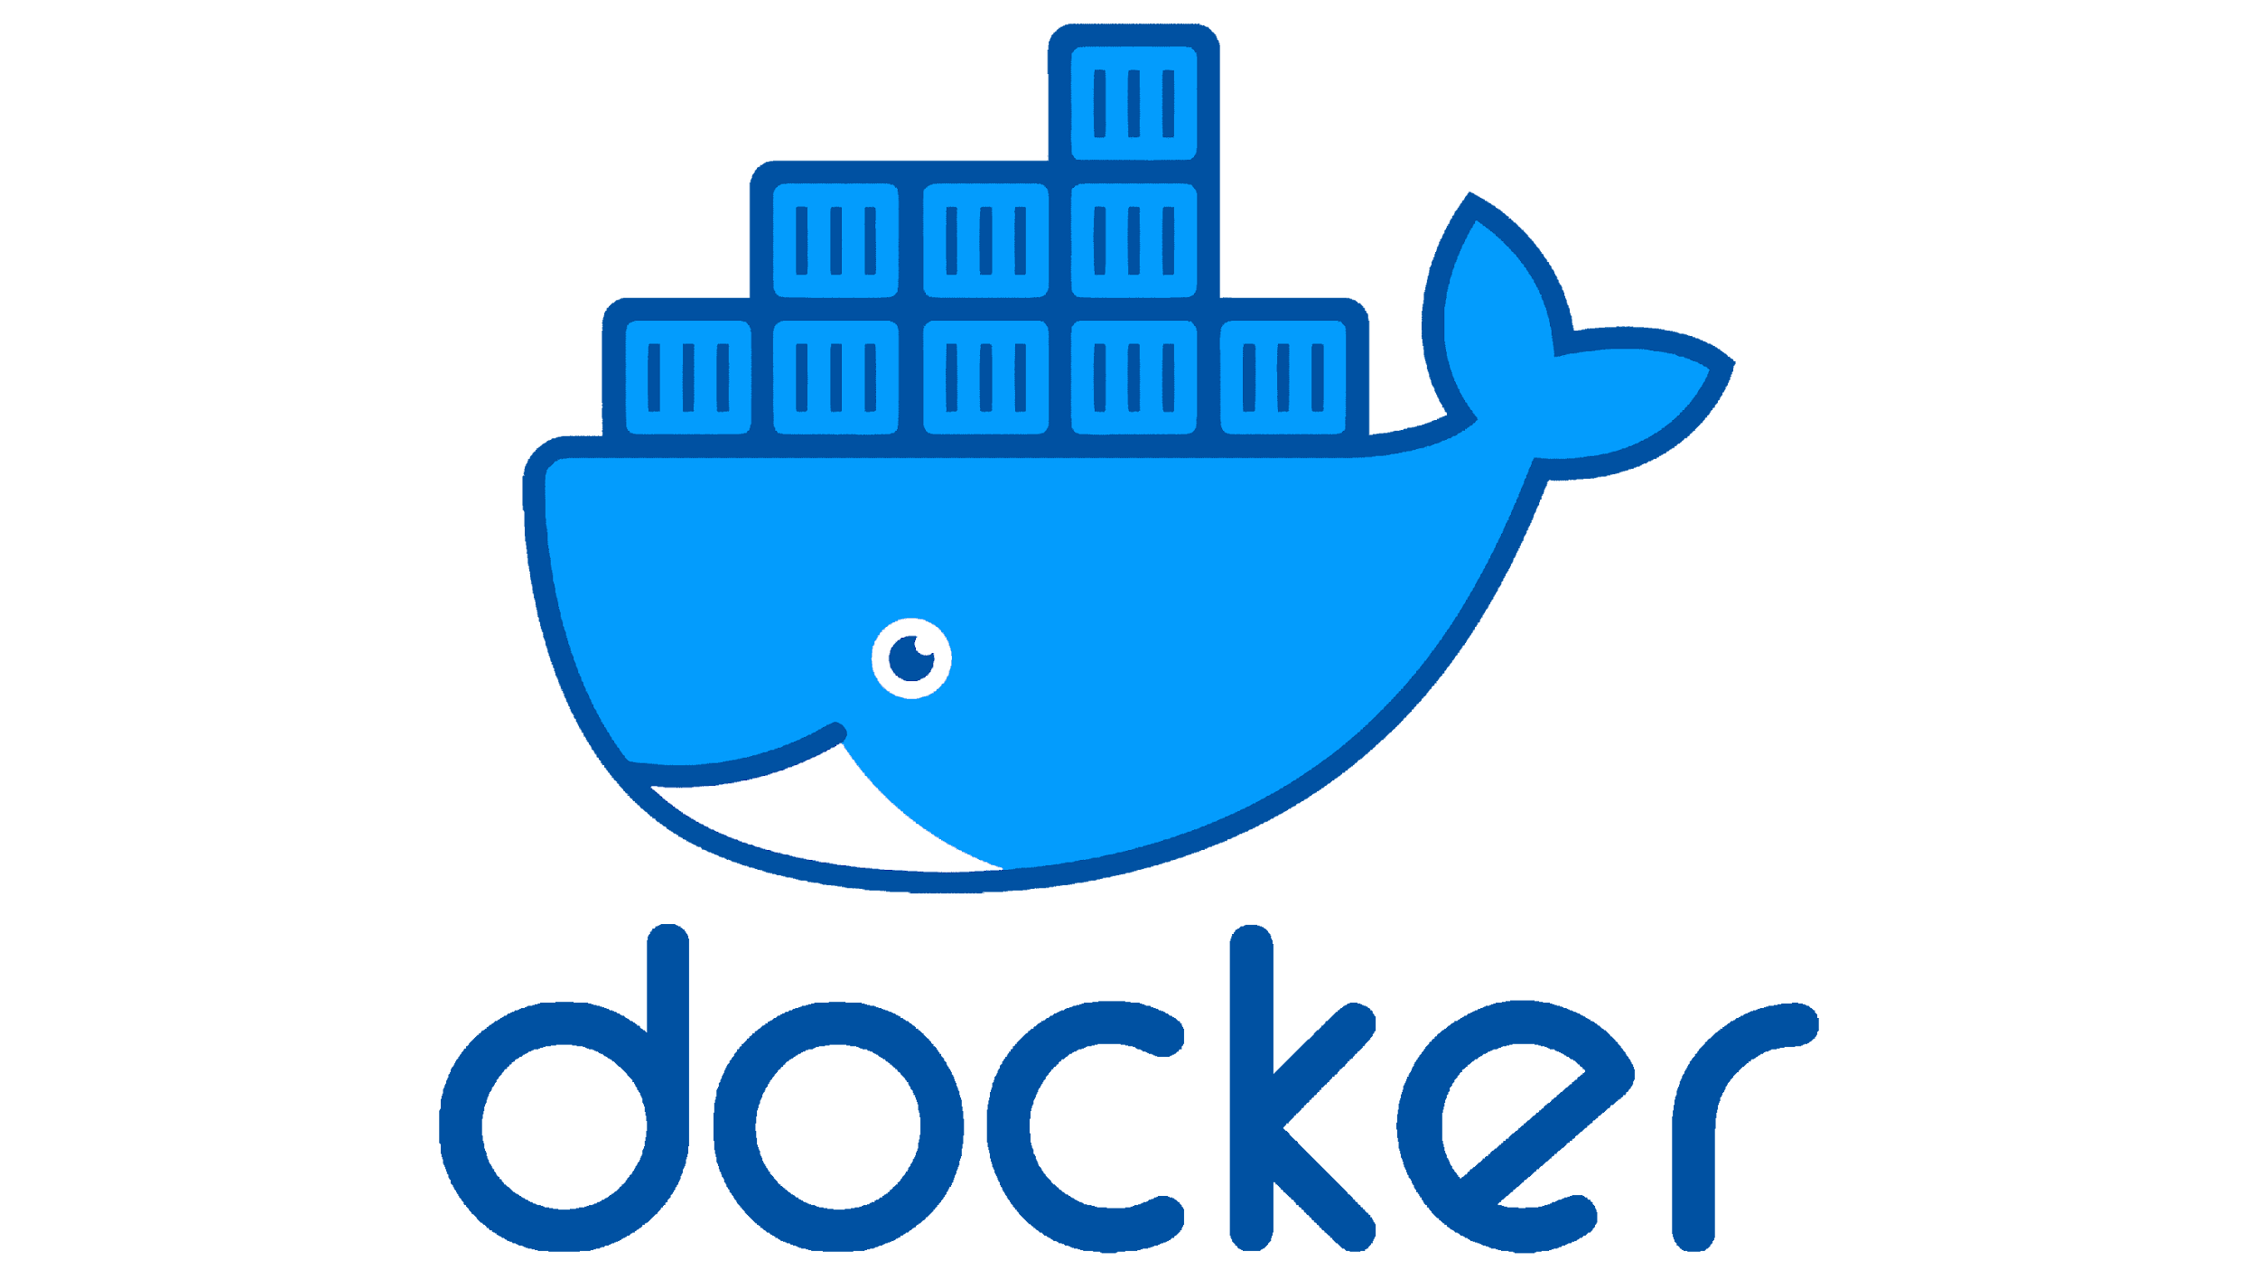
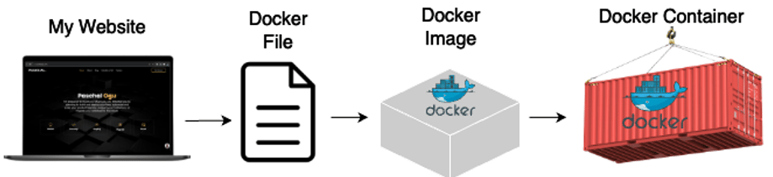
What is Docker and Why use it?
Docker Ecosystem
from DockerHub
Container
A platform for running Containers
Image file
Container
A single file with all the required libraries, package and configuration needed to run a program/app.
Container
Docker Server
Docker Compose
Instance of an image that runs a program (process)
Docker Machines
Docker Client
Docker Hub
Docker Images
Docker makes it very easy to install and run applications and programs without being worrying about software dependencies.

Slide 29
What is Docker and Why use it?
Containers: isolation without performance hits
define and manage multi-container applications.
Docker Compose
Docker Server (Daemon)
In charge of creating images and running containers
Docker Runtime
Docker Client
Command-line too to manage containers
Docker Hub
Docker Images
A template/blueprint to create a running Docker container. Image is like a Recipe
Container is like a Cake.
responsible for executing containers, managing their lifecycle, and providing isolation between applications

Slide 30
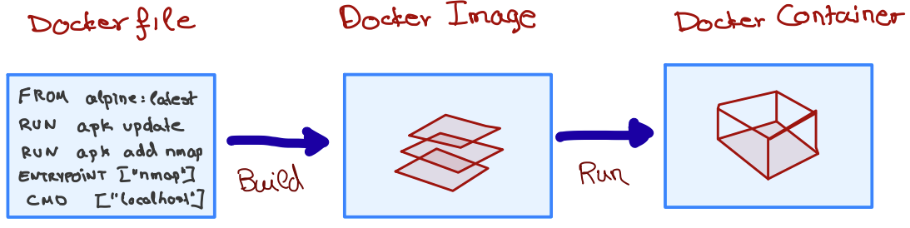
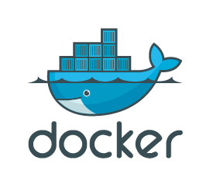
A closer look into Docker
Dockerfile, as a simple text file allows us to build the Docker Image, which are .iso files and other files. We run the Docker Image to get Docker Container.
Docker Engine creates, ships and runs Docker containers deployable on a physical or virtual, host locally, in a datacenter or cloud service provider.

Slide 31
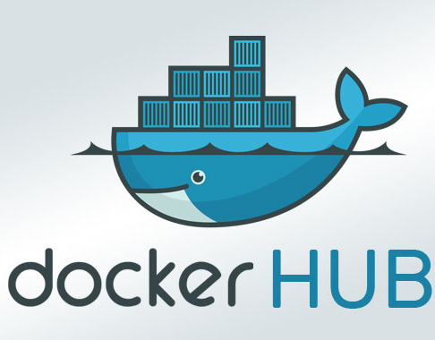
Docker Registry
storage and distribution service for your images
Centralized Place to Find, Share, and Store Docker Images!
Docker Hub is a Docker Registry, like an App Store for Docker containers.
It’s a cloud-based registry where you can find Docker Images as pre-configured software setups that you can use to run containers.
You can think of it as a place to download (pull) ready-made Docker images and also upload (push) your own images.
https://hub.docker.com/
Why Use Docker Hub?
Ready-made images: Find thousands of pre-built images, including popular ones like Nginx, MySQL, Ubuntu, and more.
Easy sharing: Share your own Docker images with others or access images shared by the community.
Public and private repositories: You can store your Docker images either publicly (for free) or privately (for a fee).

Slide 32

Docker Architecture
$ docker search <keyword>
$ docker pull <image_name>
$ docker push <image_name>

Slide 33
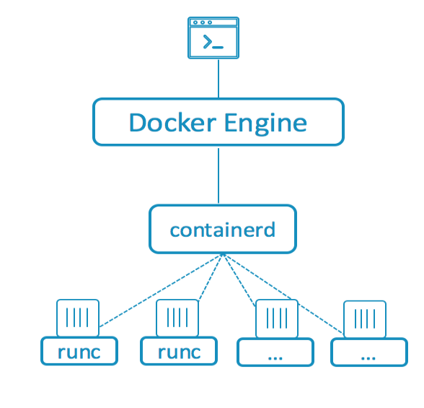
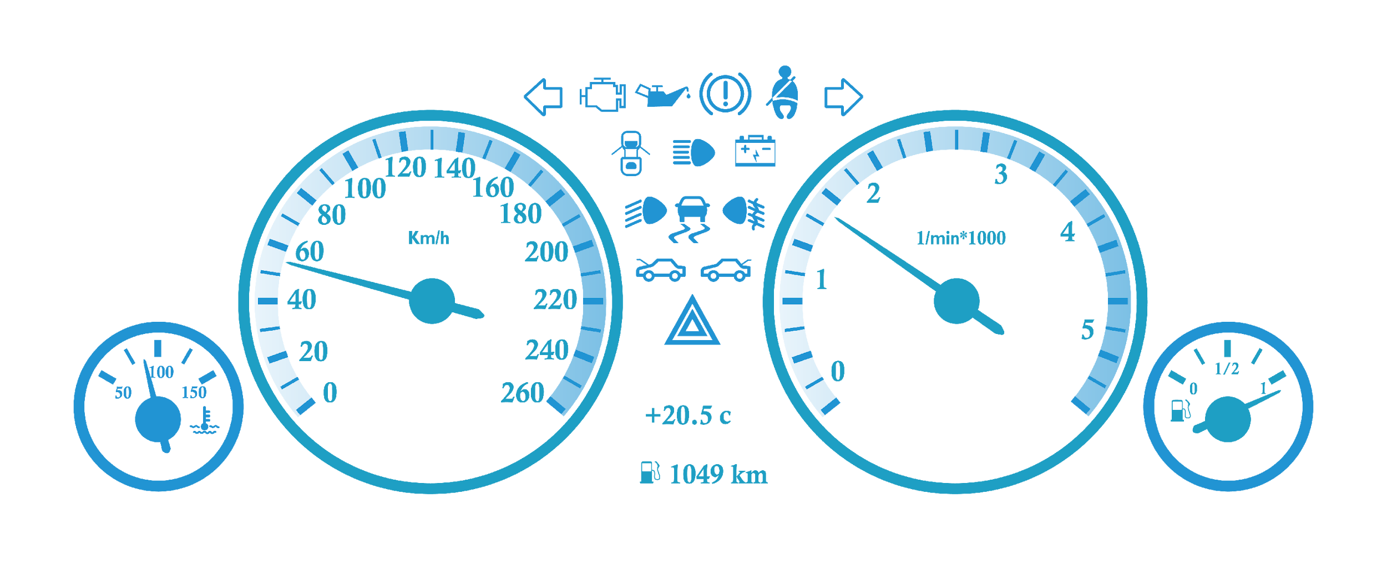
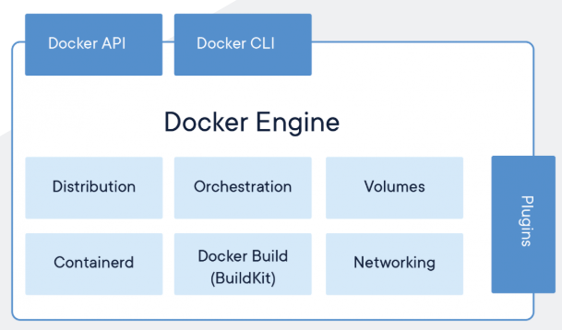
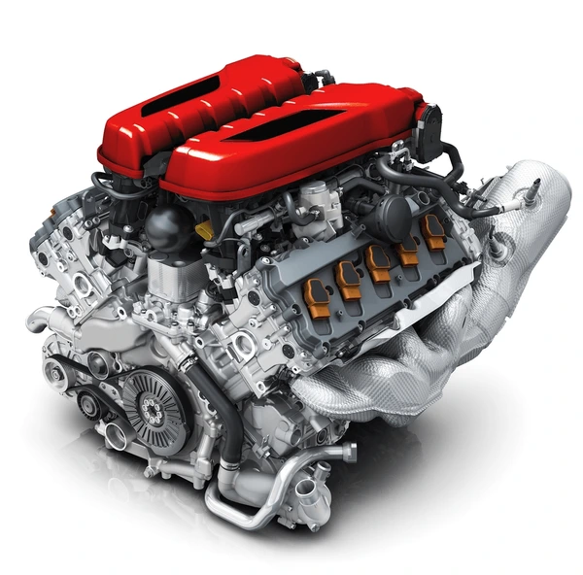
Container Engine vs Container Runtime
Driver’s dashboard vs Engine inside the car
Docker UI/CLI
Manage containers & Interacts with users
and containerd
Docker Engine communicates with containerd
https://www.docker.com/products/container-runtime/
Containerd spins up runc to run containers
Docker itself is a container engine, and relies on container runtimes under the hood to actually run the containers. In modern Docker setups, Containerd is the default runtime for managing the lifecycle of containers.
containerd → Handles container lifecycle.
runc → Low-level runtime to executes containers

Slide 34
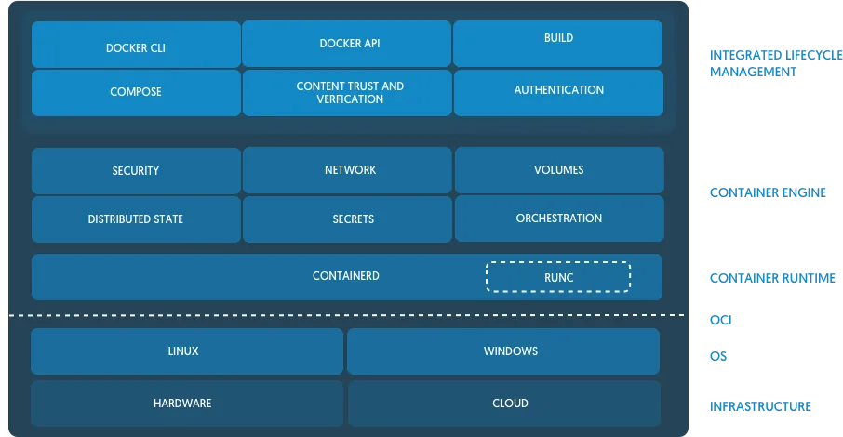
Container Engine vs Container Runtime

Slide 35
Container Networking
ubuntu@maas:~$ docker network list
NETWORK ID NAME DRIVER SCOPE
8af9761e54f3 bridge bridge local
b28ea5ab384d host host local
8e6e052ffe98 none null local
ubuntu@maas:~$ docker network inspect bridge | grep bridge.name
"com.docker.network.bridge.name": "docker0",
ubuntu@maas:~$ brctl show
bridge name bridge id STP enabled interfaces
docker0 8000.0242673cc920 no veth0ff5048
virbr0 8000.5254004a6f48 yes virbr0-nic

Slide 36
Container Networking
ubuntu@maas:~$ sudo iptables-save | grep docker
-A POSTROUTING -s 172.17.0.0/16 ! -o docker0 -j MASQUERADE
-A DOCKER -i docker0 -j RETURN
-A FORWARD -o docker0 -m conntrack --ctstate RELATED,ESTABLISHED -j ACCEPT
-A FORWARD -o docker0 -j DOCKER
-A FORWARD -i docker0 ! -o docker0 -j ACCEPT
-A FORWARD -i docker0 -o docker0 -j ACCEPT
-A DOCKER-ISOLATION-STAGE-1 -i docker0 ! -o docker0 -j DOCKER-ISOLATION-STAGE-2
-A DOCKER-ISOLATION-STAGE-2 -o docker0 -j DROP
ubuntu@maas:~$ sysctl net.ipv4.conf.all.forwarding
net.ipv4.conf.all.forwarding = 1

Slide 37
Docker Commands
Running a Simple Nginx Web Server Using Docker
2
$ docker --version
$ docker search nginx
$ docker pull nginx
$ docker image ls
$ docker run --name nginx-web-server –d –p 8000:80 nginx
$ docker ps
$ docker ps -s
$ docker logs nginx-web-server
$ docker exec -it nginx-web-server /bin/sh
$ docker stop nginx-web-server
$ docker start nginx-web-server
$ docker rm nginx-web-server
$ docker rmi nginx
Search for an image name
Pull an image from Docker Hub
List images pulled to your laptop
Run a container from an image
List running containers
Displays approximate size of containers
Check container logs
Access a shell inside a sunning container
Stop a running container
Start a stopped container
Remove a container
Remove an image
Notes:
Docker Engine: Creates, ships and runs Docker containers deployable on a physical or virtual, host locally, in a datacenter or cloud service provider. Registry Service (Docker Hub or Docker Trusted Registry): Cloud or server-based storage and distribution service for your images
docker run: Starts a new Docker container based on a specified image.--name nginx-web-server: Assigns the container a name (nginx-web-server) for easier identification and management.-d: Runs the container in detached mode, meaning it runs in the background.-p 8000:80: Maps port 8080 on the host machine to port 80 inside the container.Port 80 is the default HTTP port used by Nginx.
By doing this, you can access the web server on your host machine at http://localhost:8080.
nginx: Specifies the Docker image to use, in this case, the official Nginx image from Docker Hub.

Slide 38
A closer look into Docker
Writing a Docker file is like being given a computer with no OS and being told to install Chrome or other software on it.
How to Install Google Chrome
A Docker image is a combination of a filesystem and parameters.
Layers built on layers, and Merged together at run time.
Each Layer is stored only once no matter how many containers use it.
Install an operating System
Run your default browser
Go to chrome.google.com
Download Chrome installer
Open File/Folder Explorer
FROM
alpine
Execute the chrome installer
RUN
apk add --update nginx
CMD
[“nginx”]

Slide 39
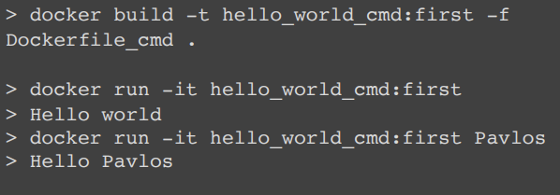
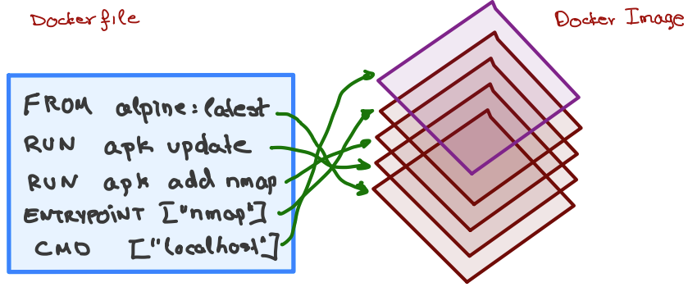
A closer look into Docker
# Use Alpine Linux as the base image
FROM alpine:latest
# Set the entry point to echo the message
ENTRYPOINT [“/bin/echo“]
# Set the default argument for the echo command
CMD [“Hello, World!“]
ENTRYPOINT
sets the command and parameters that will first execute when container is started
will override all elements specified with CMD
commands or scripts can be passed
CMD
executed after ENTRYPOINT
can pass arguments to an ENTRYPOINT main command
with CMD, commands can be overridden
The daemon reads the Dockerfile and creates a layer for every command.

Slide 40
A closer look into Docker
How to build a customized Docker Image?
$ mkdir nginx-docker
$ cd nginx-docker
$ vim index.html
$ vim Dockerfile
<!DOCTYPE html>
<html lang="en">
<head>
<meta charset="UTF-8">
<meta name="viewport" content="width=device-width, initial-scale=1.0">
<title>Welcome to My Nginx Docker</title>
</head>
<body>
<h1>Welcome to My Nginx served by a Customized Docker!</h1>
<p>This page is being served by an Nginx container!</p>
</body>
</html>
# Use the official Nginx image from the Docker Hub
FROM nginx:alpine
# Copy the HTML file into the default Nginx web directory
COPY index.html /usr/share/nginx/html/index.html
# Expose the port that Nginx will run on
EXPOSE 80
# No need to specify CMD or ENTRYPOINT because the official # Nginx image already comes with the default command to start Nginx.
$ docker build -t nginx-docker-app .
$ docker images
$ docker run –d –p 8000:80 nginx-docker-app
→ Check http://localhost:8000 in your browser

Slide 41
A closer look into Docker
How to build a customized Docker Image?
$ vim Dockerfile
More Complex Example
FROM ubuntu
LABEL maintainer="docker@example.com”
RUN \
apt-get update && \
apt-get install -y nginx && \
rm -rf /var/lib/apt/lists/* && \
echo "\ndaemon off;" >> /etc/nginx/nginx.conf && \
chown -R www-data:www-data /var/lib/nginx
COPY index.html /usr/share/nginx/html/index.html
CMD ["nginx"]
EXPOSE 80
EXPOSE 443

Slide 42
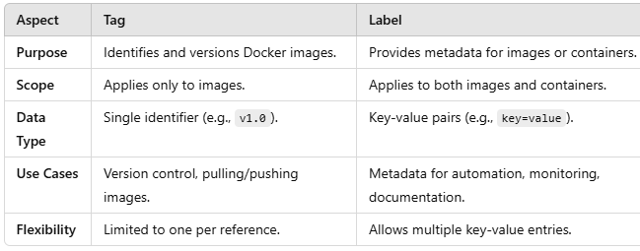
Using Tag/Label for your Docker Images
Pull the Existing Image: If the image is not on your local machine but already on Docker Hub, you need to pull it first:
$ docker pull <Dockerhub_username>/mynginx_image:v1.0
TAG
Tag the Image: Use the docker tag command to assign a new tag to the image (existing tag is v1.0, want to tag it as v1.1)
$ docker tag <Dockerhub_username>/mynginx_image:v1.0 myusername/mynginx:v1.1
Push the Newly Tagged Image: Push the newly tagged image back to Docker Hub.
$ docker push <Dockerhub_username>/mynginx_image:v1.1
LABEL
$ docker build --label maintainer="you@example.com" .
$ docker run --label environment=production mynginx_image
Notes:
https://hub.docker.com/r/5tuxnet/4912/tags

Slide 43
One more thing about Containers …
Containerized Applications
Containers are Ephemeral !?!
App G
App I
App H
App J
App K
App A
App B
App C
App D
App E
App F
Short-lived by Nature
Immutable Behavior
Stateless Design
Disposable
Container Runtime (Docker, containerd)
Kernel
Host Operating System (Window/Linux)
Physical/Hardware Infrastructure (Server)
How to manage Ephemerality?
Despite being ephemeral, containers can work with Persistent Storage to handle stateful applications. This is achieved by:
Volumes: Mounting external storage to the container.
Databases: Storing critical data in external databases instead of within the container file-system.
Configuration Management: Using environment variables, secrets, or config maps to manage settings dynamically.
This Ephemeral nature makes containers highly scalable, portable, and easy to manage.
Notes:
1. Containers are often created to run a specific task or service and are then stopped or removed once that task is complete or the service is no longer needed.If a container is terminated or crashes, any data or changes made inside the container (except for persistent volumes or external storage) will be lost.
2. Containers are based on images that define their state at startup. They can be redeployed or replaced without any significant effort, as they are stateless by default. The container is not meant to be a place for permanent state or data modification.
3. Containers are usually designed to not store state within the container itself. Any important state, logs, or data should be stored outside the container (e.g., in volumes, databases, or external storage systems).
4. Instead of repairing a broken or malfunctioning container, it's typically replaced by a new one spun up from the original image. This aligns with principles of scalability and resilience.
5. This ephemeral nature is part of what makes containers highly scalable, portable, and easy to manage in environments like Kubernetes, where they can be orchestrated and redeployed seamlessly.

Slide 44
Lecture #2 Summary
Virtualization technologies/types
Virtual Machine (VM) advantages
Containers and Dockers (vs. VMs)
Docker as de facto for containerization
Understanding Docker components and architecture
Creating a simple Docker image

Slide 45
Hands on Docker/Containers Exercise
Review of LAB #1
Exercise 1: Pull, Modify, Push Image.
Exercise 2: Build a Docker Image.
Exercise 3: Try something from NetworkChuck

Slide 46
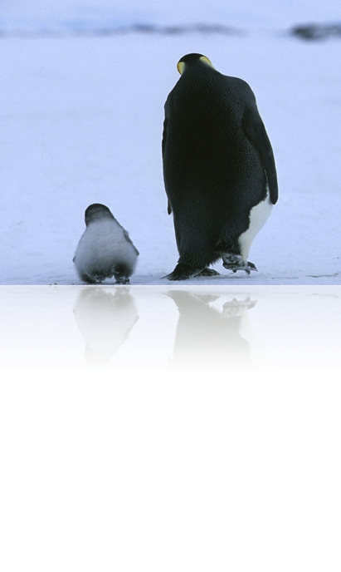
End of Lecture #2
THANK Y☺U
- Dawood Sajjadi
Notes:
Provide some cheat sheets and references for these three subjects and ask students to install them on their PCs.

